Slide 1
Simplifications of
Context-Free Grammars
Costas Busch - LSU

Slide 2
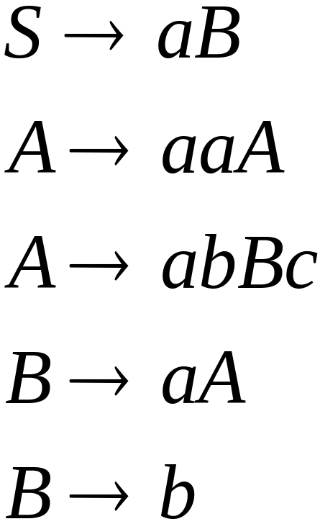
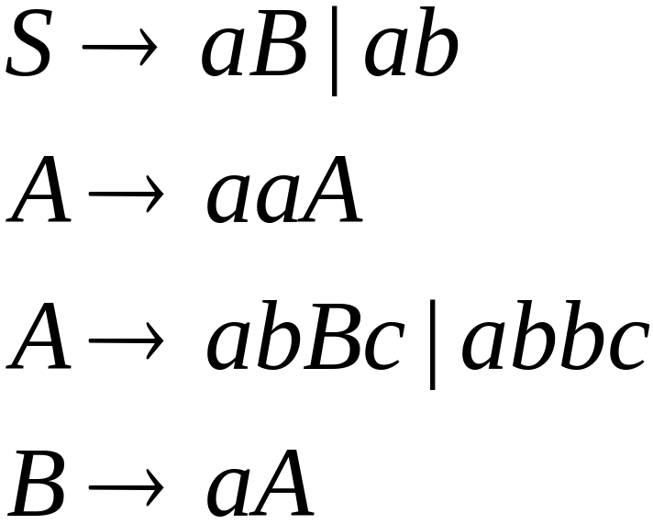

A Substitution Rule
Equivalent
grammar
Substitute
Costas Busch - LSU

Slide 3


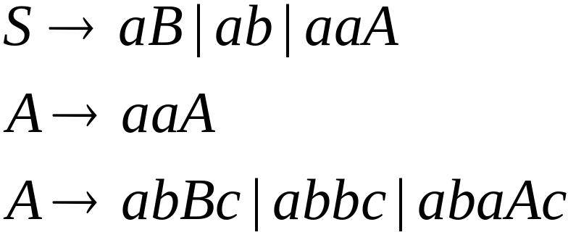
Substitute
Equivalent
grammar
Costas Busch - LSU

Slide 4
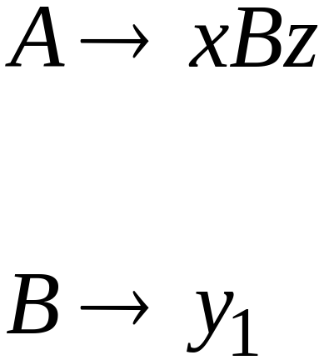
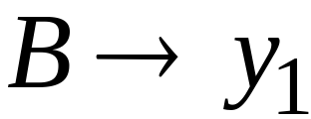
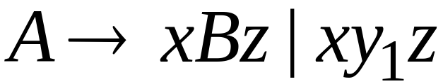
In general:
Substitute
equivalent
grammar
Costas Busch - LSU

Slide 5
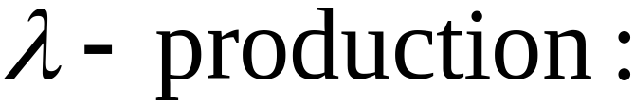

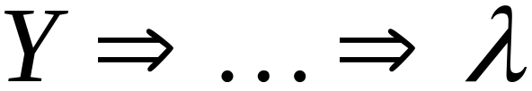
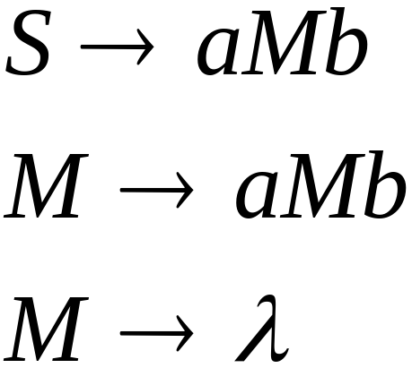
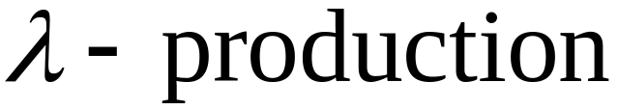
Nullable Variables
Nullable Variable:
Example:
Nullable variable
Costas Busch - LSU

Slide 6
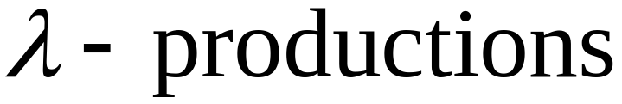
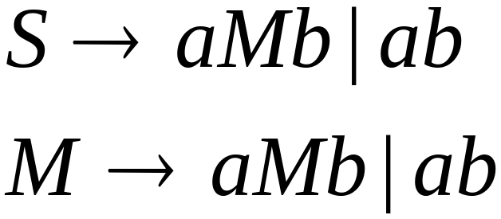

Removing
Substitute
After we remove all the
all the nullable variables disappear
(except for the start variable)
Costas Busch - LSU

Slide 7

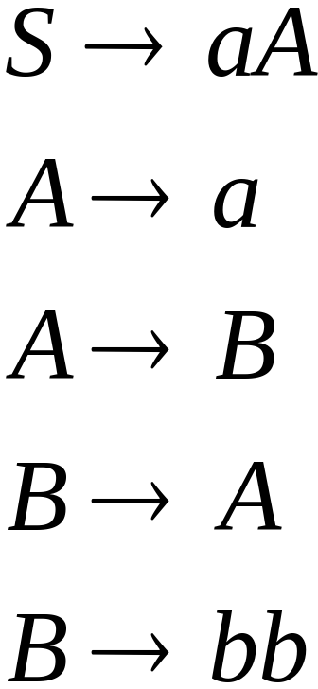
Unit-Productions
Unit Production:
(a single variable in both sides)
Example:
Unit Productions
Costas Busch - LSU

Slide 8
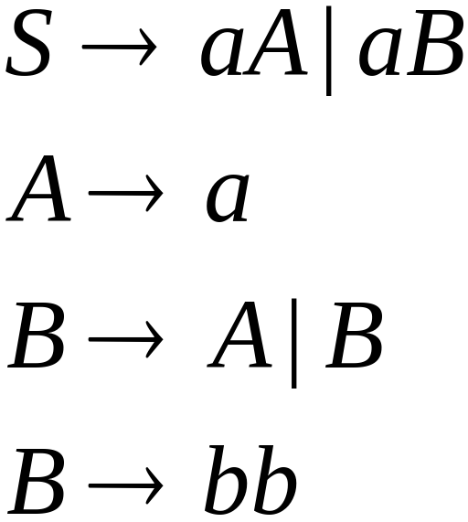

Removal of unit productions:
Substitute
Costas Busch - LSU

Slide 9

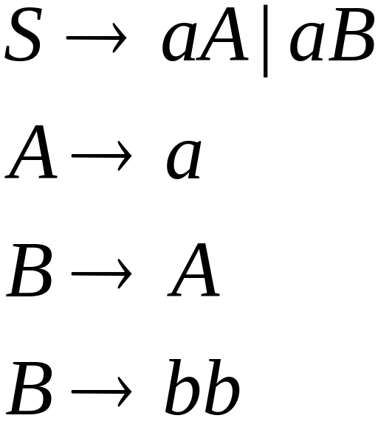

Unit productions of form
can be removed immediately
Remove
Costas Busch - LSU

Slide 10
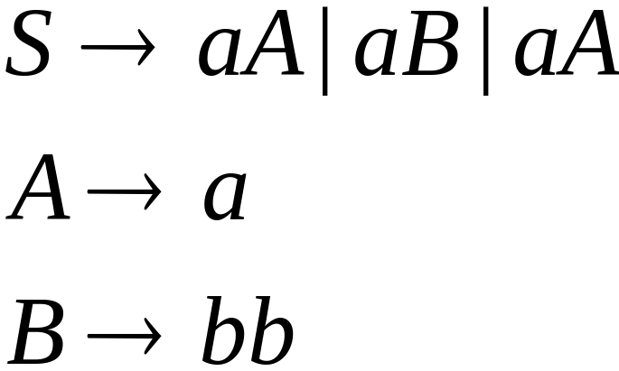

Substitute
Costas Busch - LSU

Slide 11
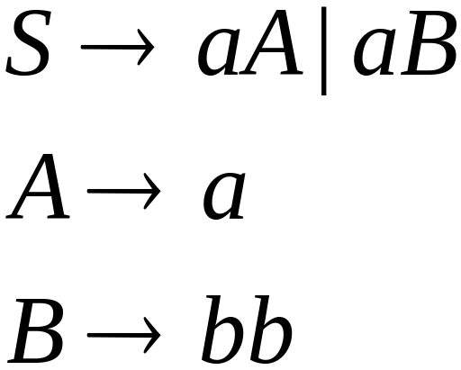
Remove repeated productions
Final grammar
Costas Busch - LSU

Slide 12
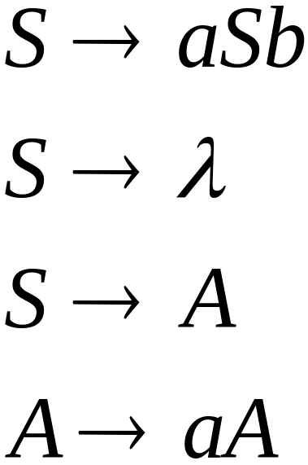
Useless Productions
Useless Production
Some derivations never terminate...
Costas Busch - LSU

Slide 13
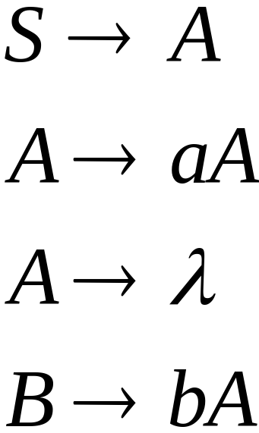
Another grammar:
Useless Production
Not reachable from S
Costas Busch - LSU

Slide 14

In general:
If there is a derivation
consists of
terminals
Then variable is useful
Otherwise, variable is useless
Costas Busch - LSU

Slide 15

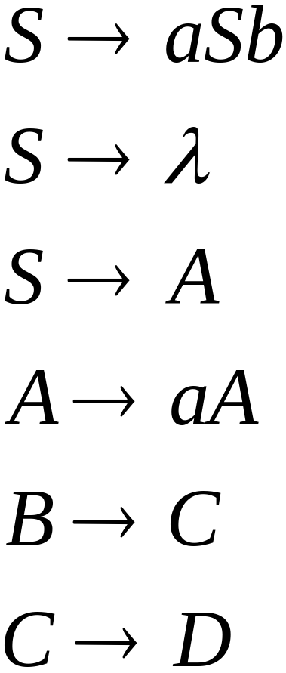
A production is useless
if any of its variables is useless
Productions
Variables
useless
useless
useless
useless
useless
useless
useless
Costas Busch - LSU

Slide 16
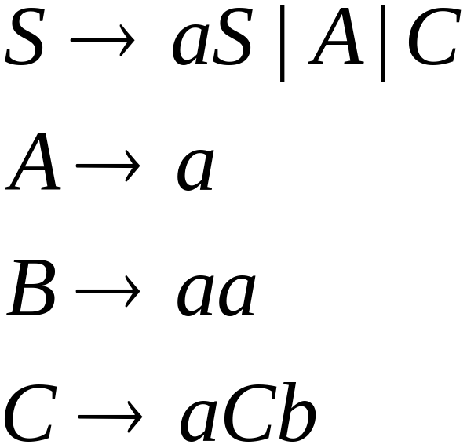
Removing Useless Variables and Productions
Example Grammar:
Costas Busch - LSU

Slide 17

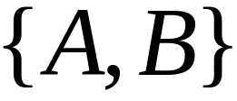
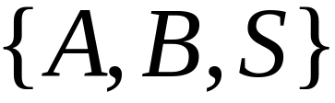
First:
find all variables that can produce
strings with only terminals or
(possible useful variables)
Round 1:
(the right hand side of production
that has only terminals)
Round 2:
(the right hand side of a production
has terminals and
variables of previous round)
This process can be generalized
Costas Busch - LSU

Slide 18
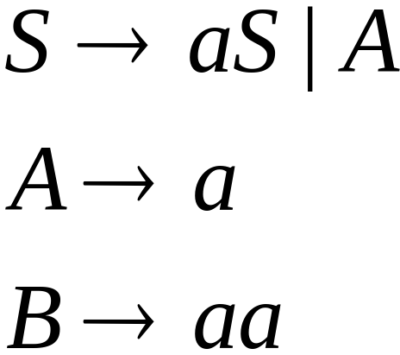
Then, remove productions that use variables
other than
Costas Busch - LSU

Slide 19




Second:
Find all variables
reachable from
Use a Dependency Graph
where nodes are variables
unreachable
Costas Busch - LSU

Slide 20
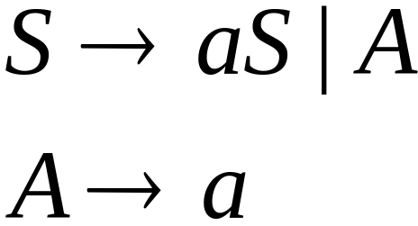
Keep only the variables
reachable from S
Final Grammar
Contains only
useful variables
Costas Busch - LSU

Slide 21
Removing All
Step 1: Remove Nullable Variables
Step 2: Remove Unit-Productions
Step 3: Remove Useless Variables
This sequence guarantees that
unwanted variables and productions
are removed
Costas Busch - LSU

Slide 22
Normal Forms for
Context-free Grammars
Costas Busch - LSU

Slide 23


Chomsky Normal Form
Each production has form:
or
variable
variable
terminal
Costas Busch - LSU

Slide 24
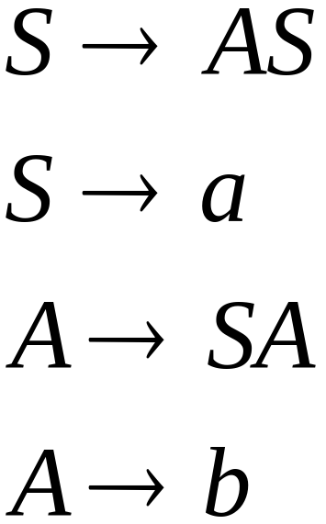
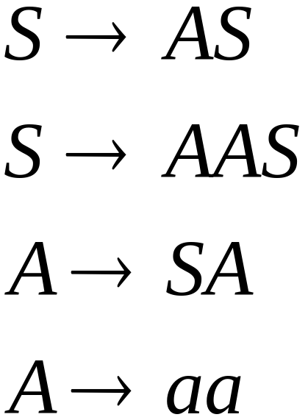
Examples:
Chomsky
Normal Form
Not Chomsky
Normal Form
Costas Busch - LSU

Slide 25
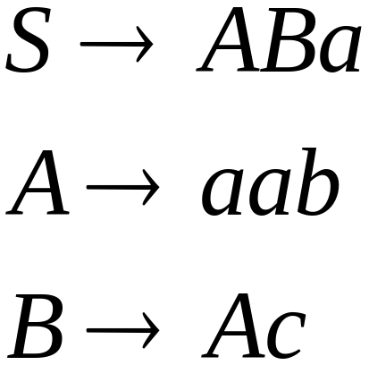
Conversion to Chomsky Normal Form
Example:
Not Chomsky
Normal Form
We will convert it to Chomsky Normal Form
Costas Busch - LSU

Slide 26
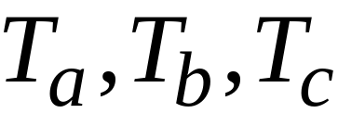
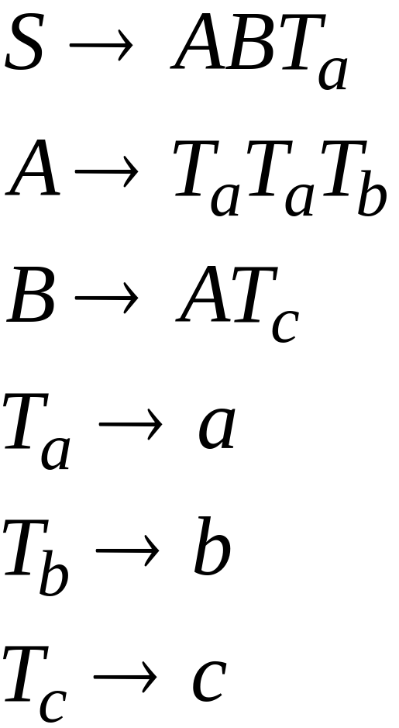
Introduce new variables for the terminals:
Costas Busch - LSU

Slide 27

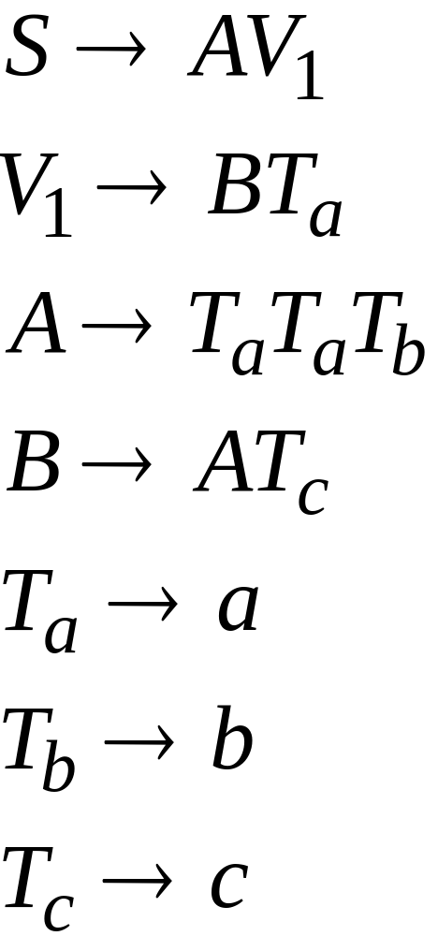
Introduce new intermediate variable
to break first production:
Costas Busch - LSU

Slide 28
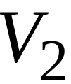
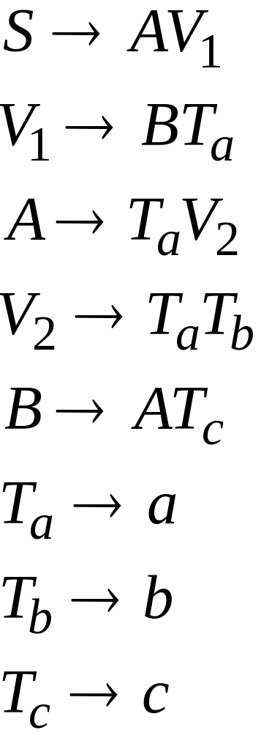
Introduce intermediate variable:
Costas Busch - LSU

Slide 29
Final grammar in Chomsky Normal Form:
Initial grammar
Costas Busch - LSU

Slide 30

In general:
From any context-free grammar
(which doesn’t produce )
not in Chomsky Normal Form
we can obtain:
an equivalent grammar
in Chomsky Normal Form
Costas Busch - LSU

Slide 31
The Procedure
First remove:
    Nullable variables
    Unit productions
(Useless variables optional)
Costas Busch - LSU

Slide 32


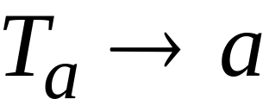
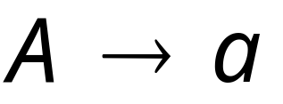
Then, for every symbol :
New variable:
Add production
In productions with length at least 2
replace with
Productions of form
do not need to change!
Costas Busch - LSU

Slide 33
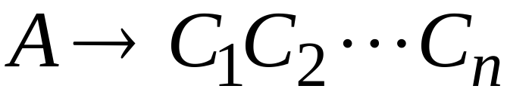
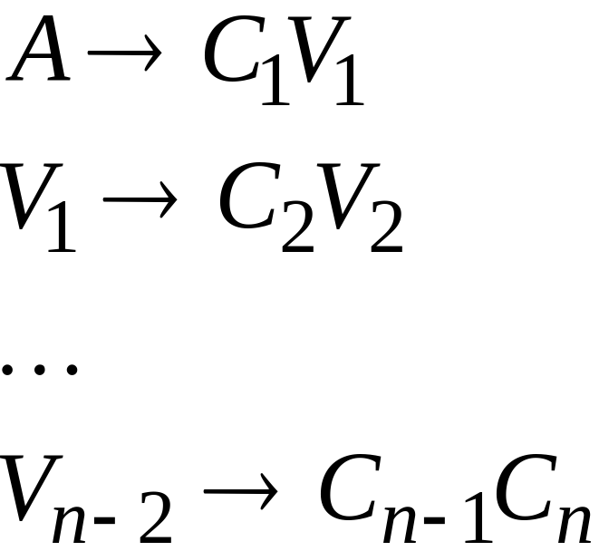
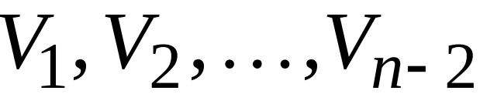
Replace any production
with
New intermediate variables:
Costas Busch - LSU

Slide 34
Observations
Chomsky normal forms are good
for parsing and proving theorems
It is easy to find the Chomsky normal
form for any context-free grammar
(which doesn’t generate )
Costas Busch - LSU

Slide 35
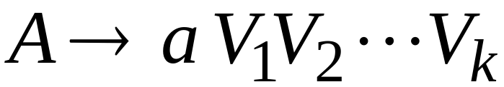

Greinbach Normal Form
All productions have form:
symbol
variables
Costas Busch - LSU

Slide 36
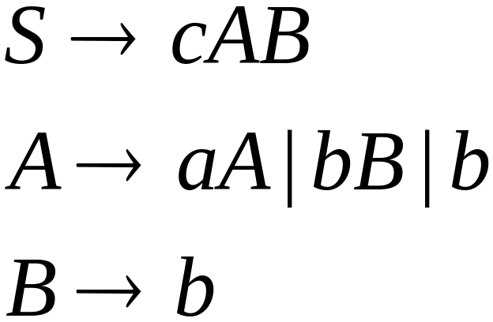
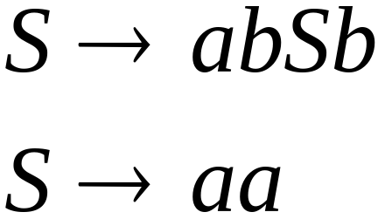
Examples:
Greinbach
Normal Form
Not Greinbach
Normal Form
Costas Busch - LSU

Slide 37
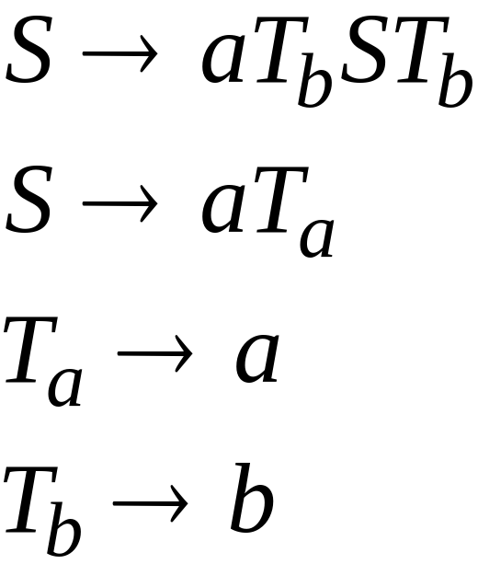
Conversion to Greinbach Normal Form:
Greinbach
Normal Form
Costas Busch - LSU

Slide 38
Observations
Greinbach normal forms are very good
for parsing strings (better than Chomsky Normal Forms)
However, it is difficult to find the
Greinbach normal of a grammar
Costas Busch - LSU

